Slide 1
Welcome to the Year 3 English and Maths Information Evening 2014

Slide 3
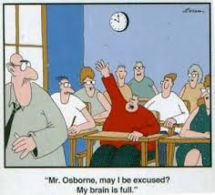
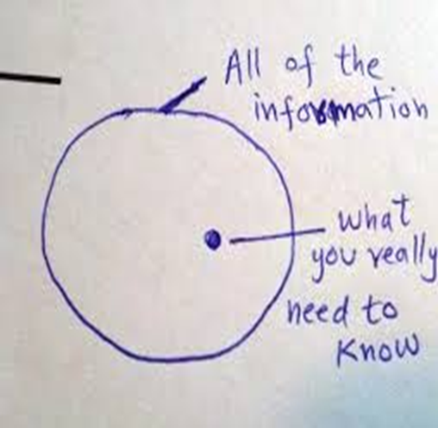
Information – the right balance

Slide 4
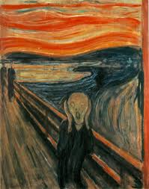
Sets
4 sets
Right place, right time
Same work
Movement
Don’t dictate future choice

